Slide 1
Distributed optimization using ADMM
A general approach for decomposing multi-stage NLP
Norwegian University of Science and Technology
Sandeep Prakash

Slide 2
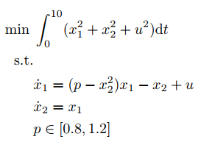
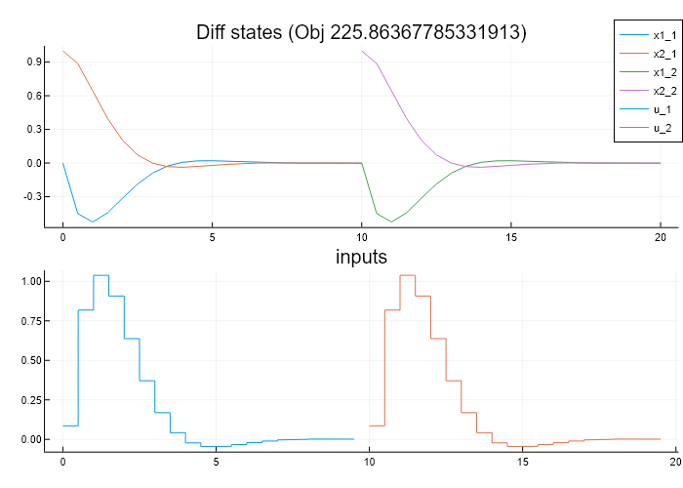
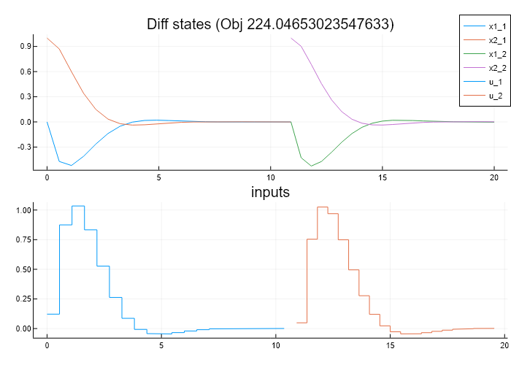
Using Ipopt to directly model a discontinuity
Fixed number of Finite elements, but Time added as a variable
Testing code using Vander Pol oscillator (p = 1, Initial Value (0,1))
Top fig – T1,T2 fixed @ 10
Bottom – 9<=T1/T2 <=11
Ipopt struggles a bit, but able to reach a solution

Slide 3
Distributed optimization using ADMM
A general approach for decomposing multi-stage NLP
Norwegian University of Science and Technology
Sandeep Prakash
Meeting with Larry 16/10/2020

Slide 4
My Story… So far
Optimal Control of a TES system
- NLP (and throw it all into Ipopt)
Optimal Design
- LP (many scenarios and long horizons)
- Unhappy with the linear approximations, but hard to solve the very large NLP otherwise
Decomposition
L shape method (Birge – Stochastic Programming)
Primal, Dual decomposition (papers - Dinesh)
ADMM

Slide 5
ADMM – Quick Theory
Solve
The augmented Lagrangian:
Method of Multipliers algorithm:
ADMM Algorithm:

Slide 6
ADMM for consensus problems
Based from (Ch 7, Boyd 2010)

Slide 7
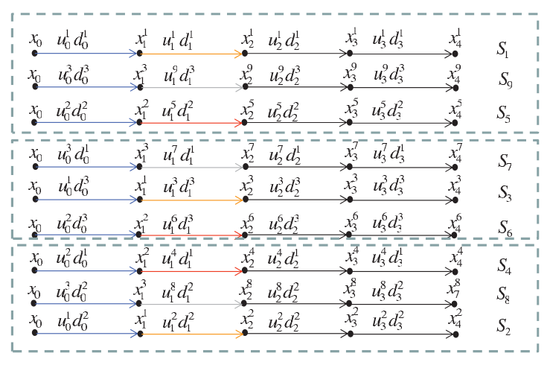
Decomposing a two-stage NLP – previous works
Scenario/ Bundle decomposition – (Lucia 2013)
Linked by Non Anticipativity Constraints
Primal/ Dual/ PH (special case of ADMM) (Martí 2015)
Coupling across single horizon (Jose 2018)
Linked by continuity of Differential states
Combine both approaches
Linked by a very general form
1st stage Design variables
2nd stage differential states

Slide 8


A simple mixing tank model for TES
Has a trivial solution for optimal operation
1st stage Design variables
Volume of the Tank (V^{tes})
Area of the Heat exchanger (A^{whb})
Operations d.o.f – (red in fig)
2nd stage Differential states
T^{tes}
T^{phb}
T^{whb}_{1-nCell}

Slide 9
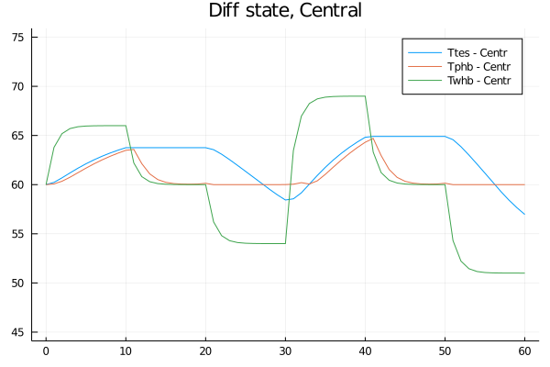
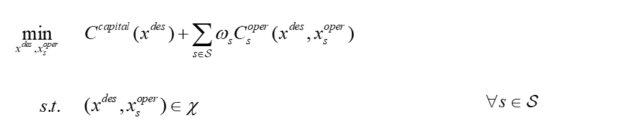
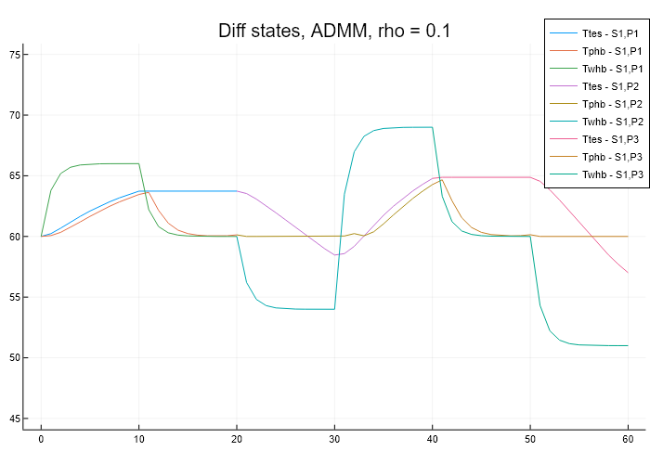
Example - SX1,PX3
Converges to same local solution as central approach

Slide 10
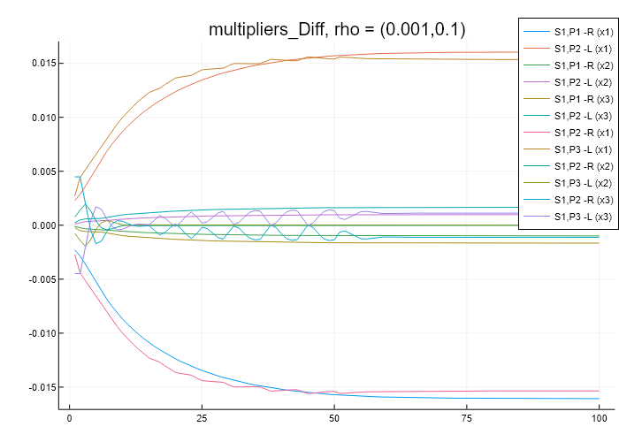
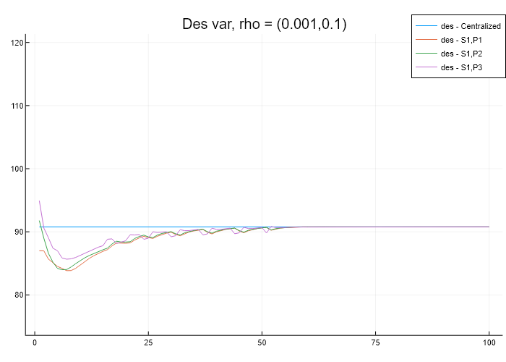
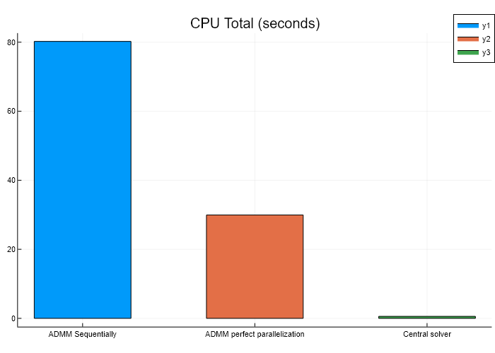
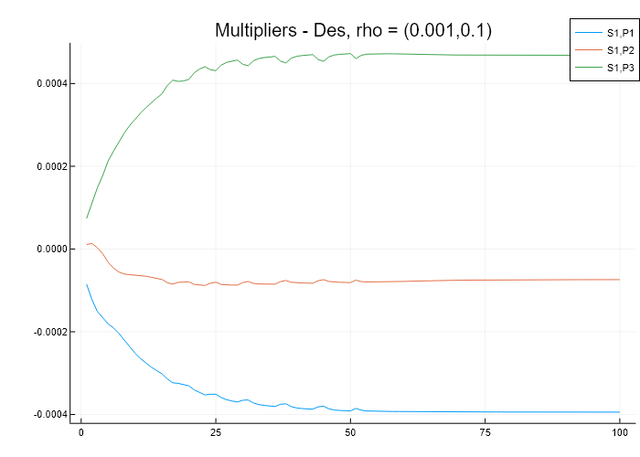
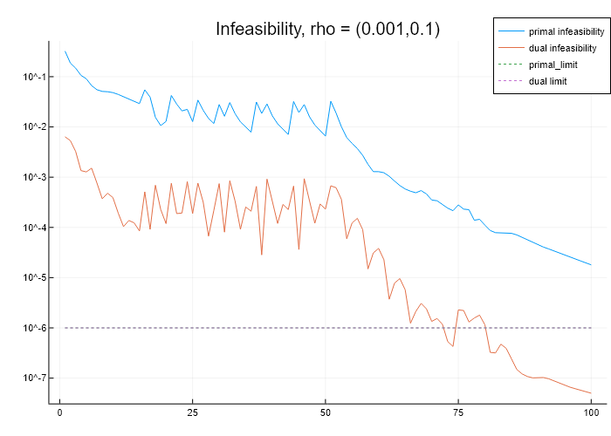
ADMM convergence
Convergence speed improved by having separate tuning parameters
Chosen according to lagrange multiplier of linking constraints

Slide 11
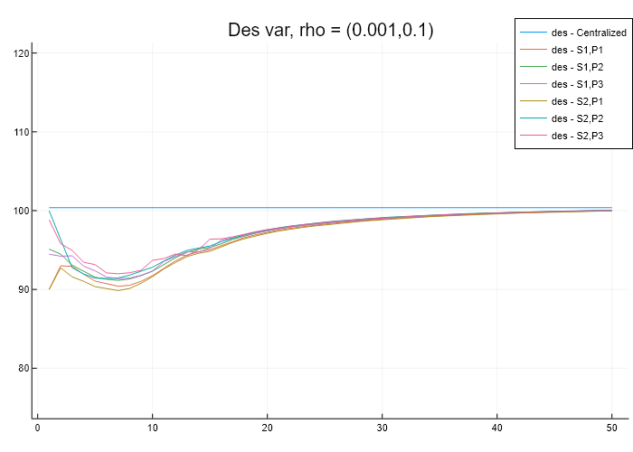
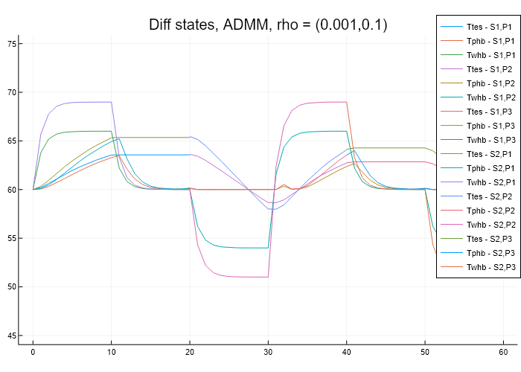
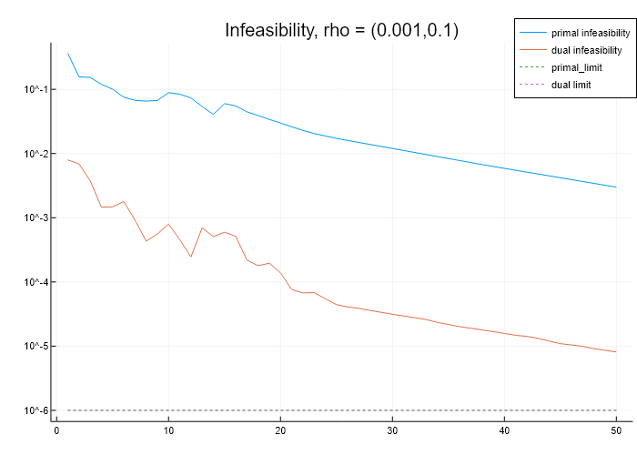
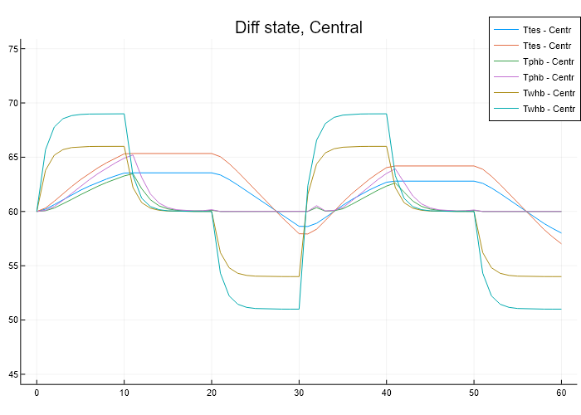
Example – SX2,PX3
Converges fairly fast (around 50 iters)

Slide 12
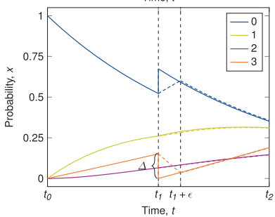
PhD theme – Production Optimization with Degrading Equipment
Using ADMM for linking a discontinuous profile (Maintenance planning case)
Fixed number of discontinuities
f₂(x₂)
f₁(x₁)
Linear complicating constraints for ADMM algo
Discard ?– because of challenges with variable finite elements.
MPECS much better way I guess

Slide 13
PhD theme – Production Optimization with Degrading Equipment
Bring NLPs to planning layers (the little people)
Concepts I know just enough to be totally confused about now
MPEC
for integer variables in a planning formulation ?
Internal Decomposition (Carl Laird and co)
Exploit KKT matrix block structure to make it parallelizable ?
Reduced models
To represent a nonlinear dynamic process as LP in a planning MPEC problem ?
Sensitivities

Slide 14
BACKUP SLIDES

Slide 15
Understanding the links between these established concepts
Quadratic penalty methods
Interior point method
Barrier term updates
ALADIN Algo for distributed nonconvex optimization ??

Slide 16
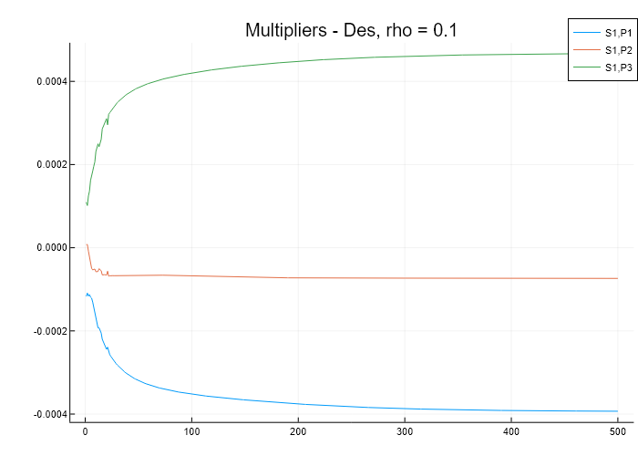
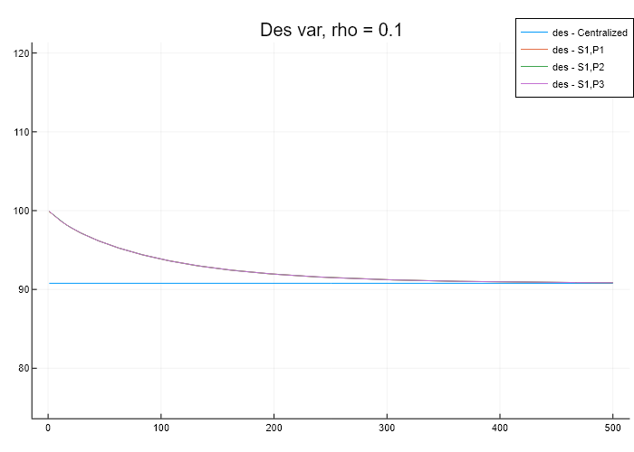
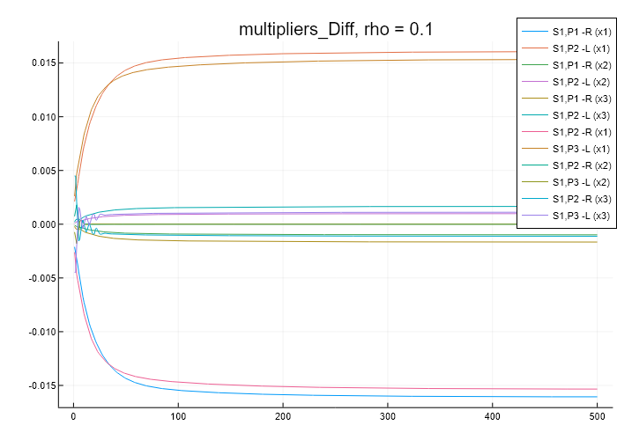
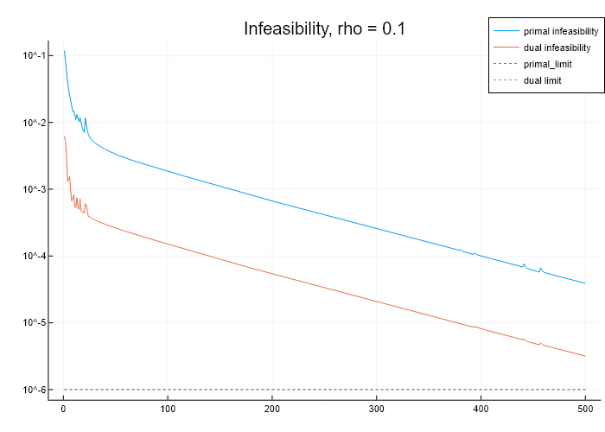
ADMM Convergence
Design variable very slow to converge, but able to find same solution
Multipliers in different orders of magnitudes
Des – 4e-4
Differential – 1e-2 (start temp in partitions)

Slide 17
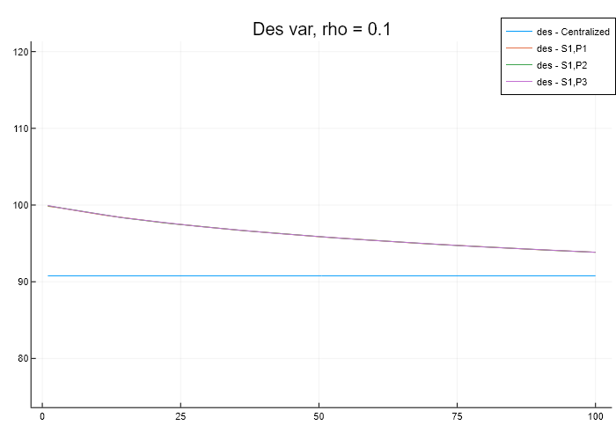
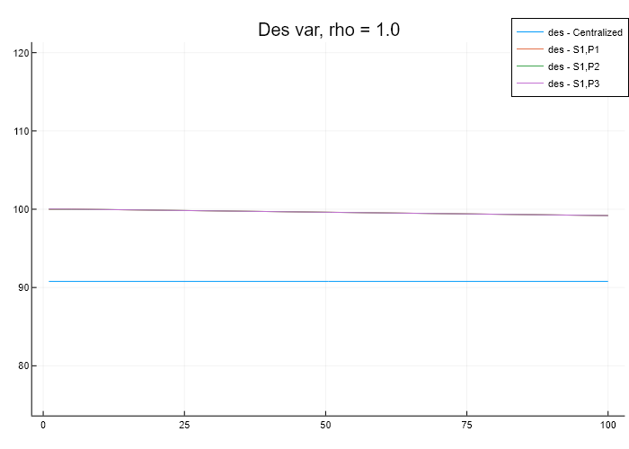
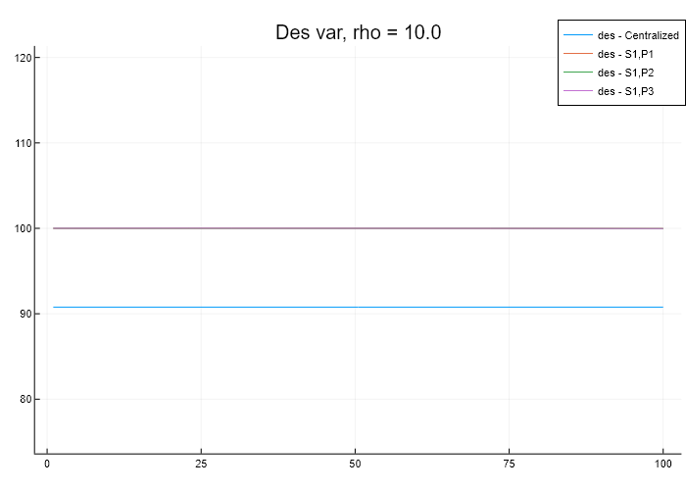
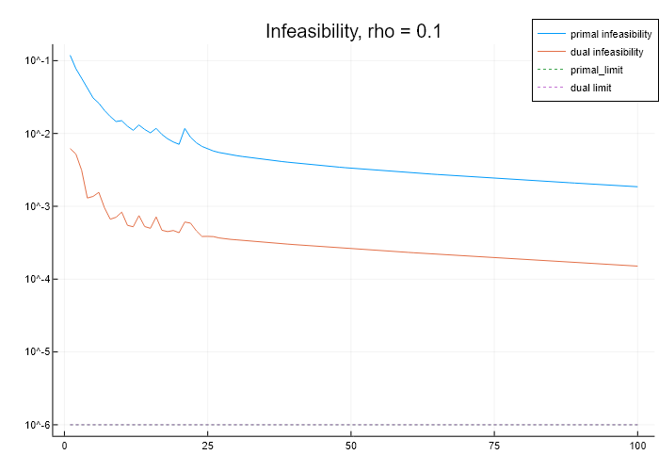
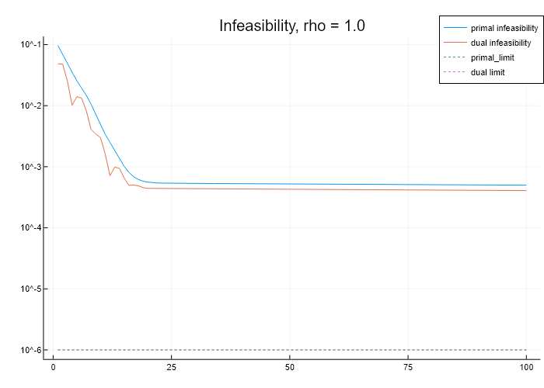
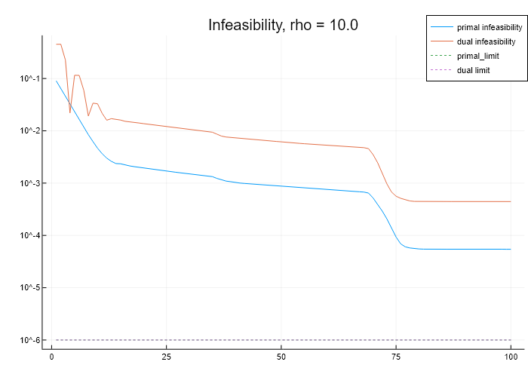
Varying rho (1e-1 to +1)
Sx2,Px3 case. 100 iterations

Slide 18
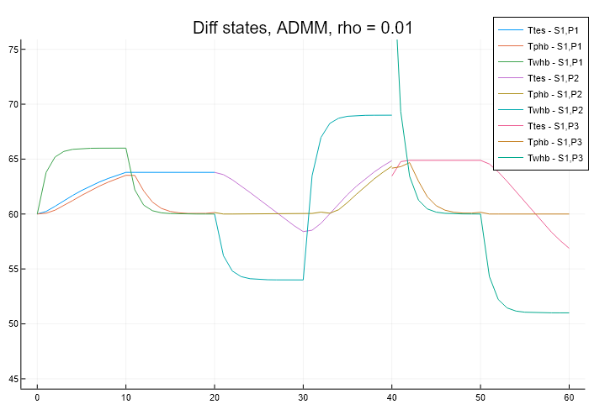
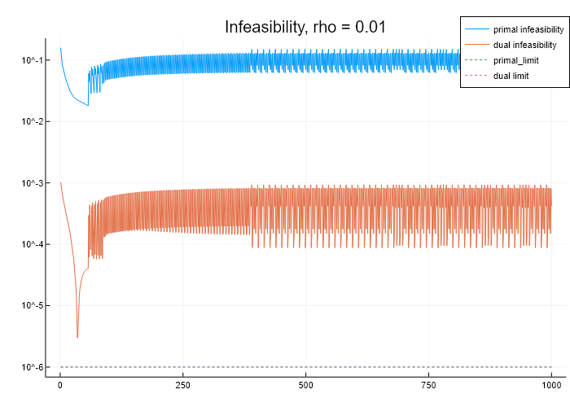
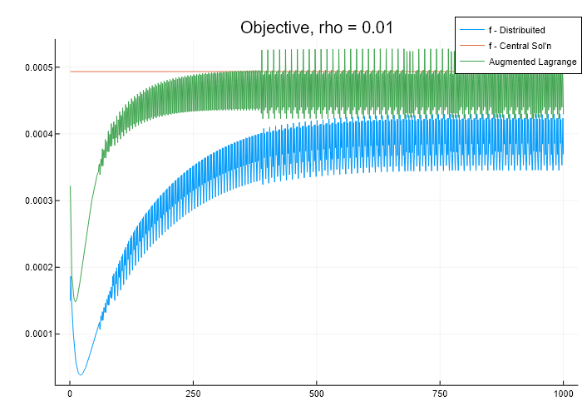
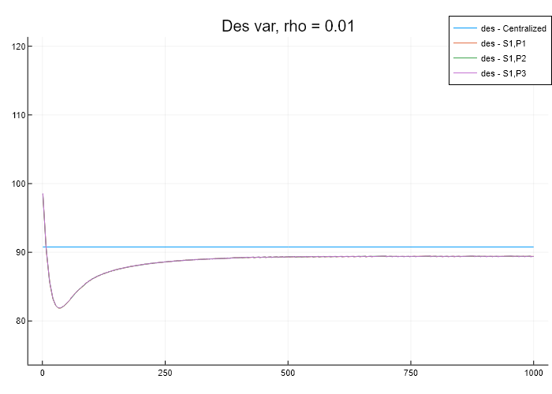
Too low rho (rho = 0.01)
Not converging even after 1000 iterations

